Slide 1
Combatting Market Erosion An Analytics-Based Strategy for Variant Injectable Anesthetic Brand
BIA 810
Health Care Data & Analytics
Final Project
Group 1

Slide 2
PROBLEM STATEMENT:
Our company introduced new variant Product 2 (J2250) and wanted to cannibalized our original Product 1(J1885). However, Product 3 (J3010) and Product 4(J2704) re-capturing the market at a rapid rate, while sales of Product 2 are decreasing over the years.
BUSINESS SOLUTION:
We propose focusing on the right doctors, increasing our presence in key territories, and making Product 2 easier and more affordable to prescribe. This includes stronger brand messaging, better support for prescribers, and resolving any access or pricing issues.
BUSINESS IMPACT:
This solution will
Enhance: Doctor trust and usage of Product 2 by making it more visible, accessible, and appealing.
Reduce: Loss of market share—by aiming to win back about 10% of doctors and 30% of patients who’ve switched to other brands.
Support: Sales and marketing goals like reaching the right doctors, improving brand messaging, and using budgets more effectively.
Solve: It helps fix why Product 2 is falling behind—by getting it in front of more doctors, removing barriers to access, and making it a clearer choice over competitors.
Executive Summary

Slide 3
Problem Summary
III. Uncover Data Gaps and Future Exploration Areas
Define other data acquisition needs to enhance decision-making
IV. Inferences and Possible Reasons/ Rationale
V. Listing and prioritizing Recommendations
i) Changes in sales force distribution and positioning
ii) Strategies for customer targeting and brand positioning
Steps to conduct Root Cause Analysis of why Product 3 is performing better than Product 2 based on following steps:
I. Assess Market Dynamics and Competitive Landscape
i) Calculating share of claims, HCPs, and patients per product.
ii) Identifying top 5 territories with largest drops in claims for Product 2
II. Identify Key Market Driver Trends
i) Mapped patient diagnosis and HCP specialty trends
ii) Analyzed patient demographics, especially age distribution across brands
iii) Tracked new vs. continuing prescribers for each brand from 2016–2018.

Slide 4
Market Basket
Brand
Relationship
Procedure
Code
Generic Name
Product Description
Market Leader (Our old product) | J1885 | ketorolac tromethamine | Ketorolac is used for the short-term treatment of moderate to severe pain in adults. It is usually used before or after medical procedures or after surgery
Variant Brand (Our new product) | J2250 | midazolam hydrochloride | Intravenously injected for induction of general anesthesia
Main Competitor Brand | J3010 | fentanyl citrate | For analgesic action of short duration during the anesthetic periods, premedication, induction and maintenance, and in the immediate postoperative period (recovery room) as the need arises
Alternative Competitor Brand | J2704 | propofol | Propofol injection is used to help you relax or sleep before and during surgery or other medical procedures. This medicine is an anesthetic and a sedative
Ketotrom
Midoride
Fentirate
Profativ

Slide 5
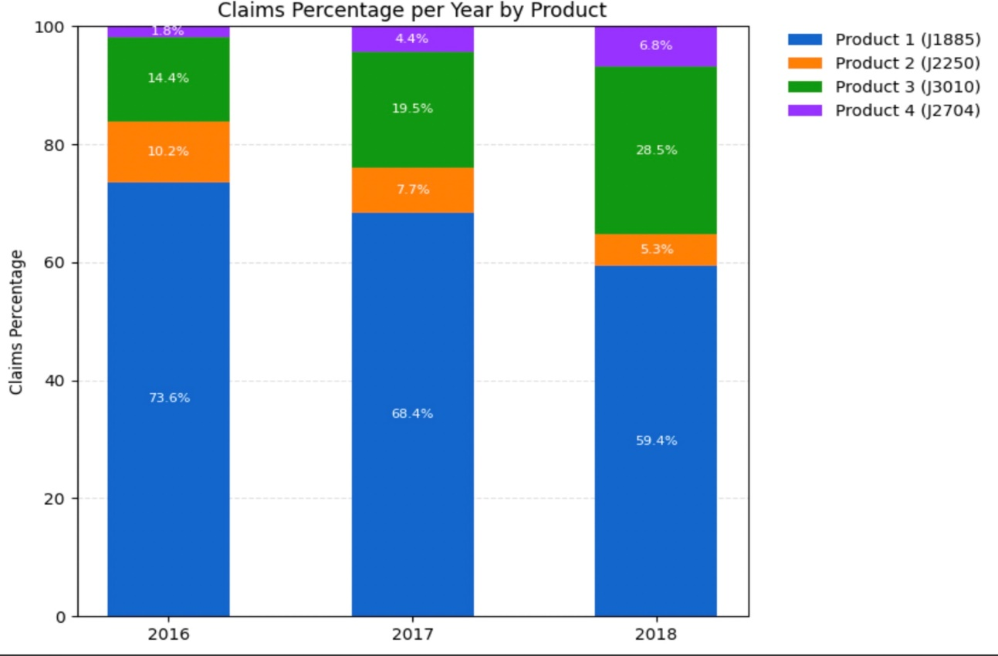
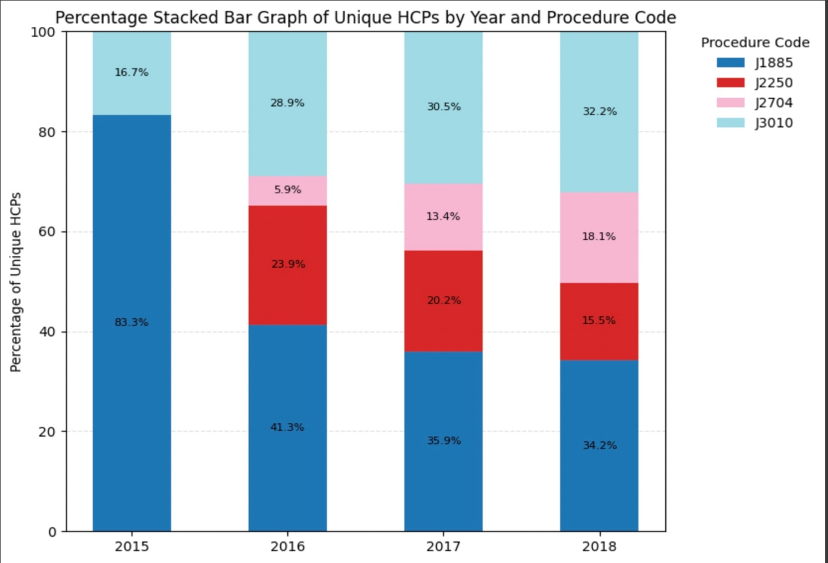
Assess Market Dynamics and Competitive Landscape
Observations:
Product 2’s claims dropped from 10.2% in 2016 to 5.3% in 2018; HCP share fell from 23.9% to 15.5%.
Product 3 doubled its claims from 14.4% to 28.5% and increased HCP share from 16.7% to 32.2%.
Product 4 grew steadily, with HCP share rising from 5.9% to 18.1%.
Key Insights:
Product 2 is losing share despite overall market growth in HCPs and patients.
Competitors are aggressively expanding prescriber and patient bases.
Decline is likely due to internal issues—not external market conditions.

Slide 6
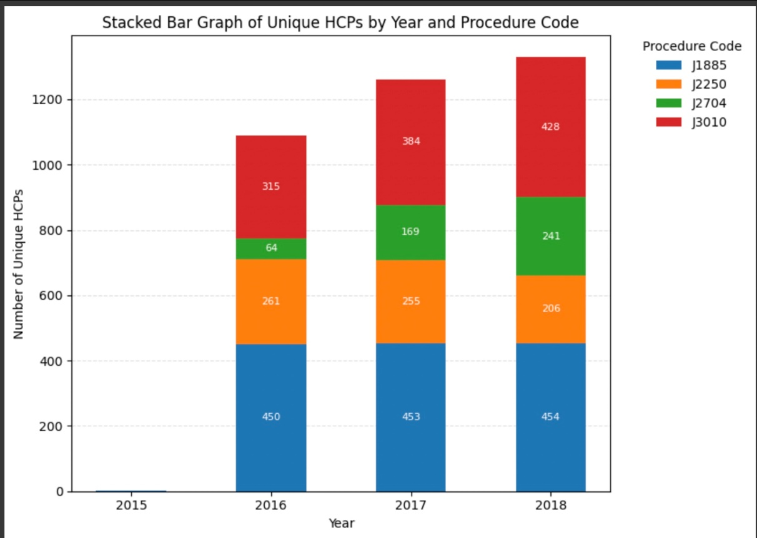
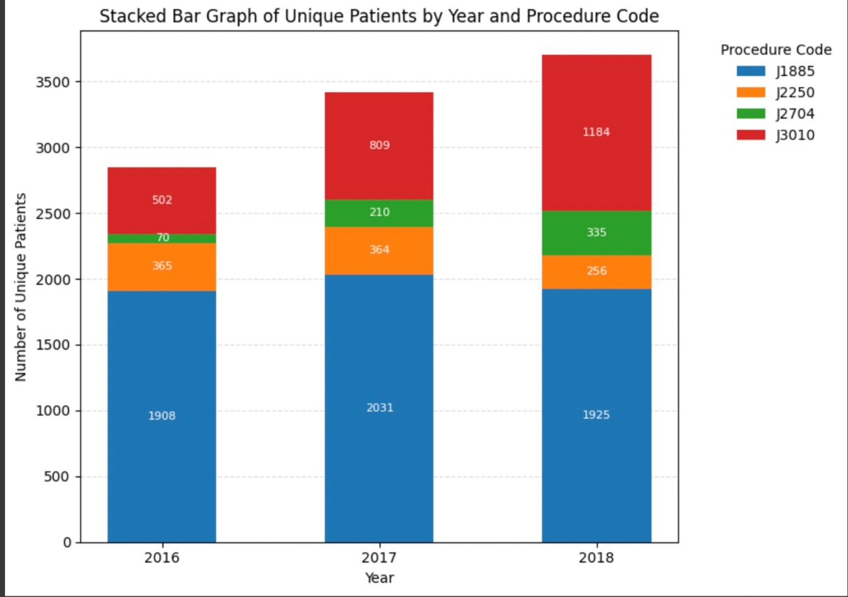
Assess Market Dynamics and Competitive Landscape
Product 2 is losing ground: HCPs prescribing J2250 dropped by 21% and patients by 30%, while Product 1 (J1885) showed no real growth.
Competitors are surging: Product 3 (J3010) saw a 36% rise in HCPs and 136% in patients, and Product 4 (J2704) exploded with 2.7 times more HCPs and 3.79 times more patients.
Key takeaway: Even as the overall market grows, our products are losing share, pointing to internal issues like brand positioning, HCP engagement, or access—not market demand.

Slide 7
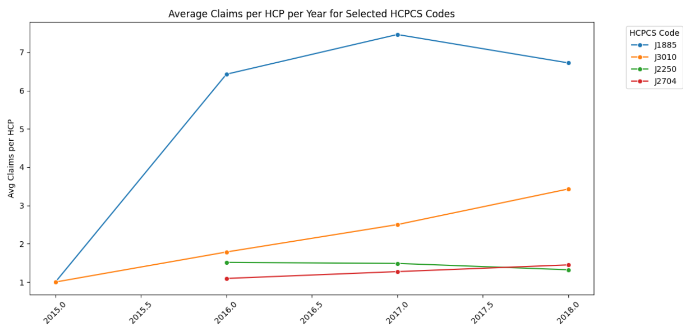
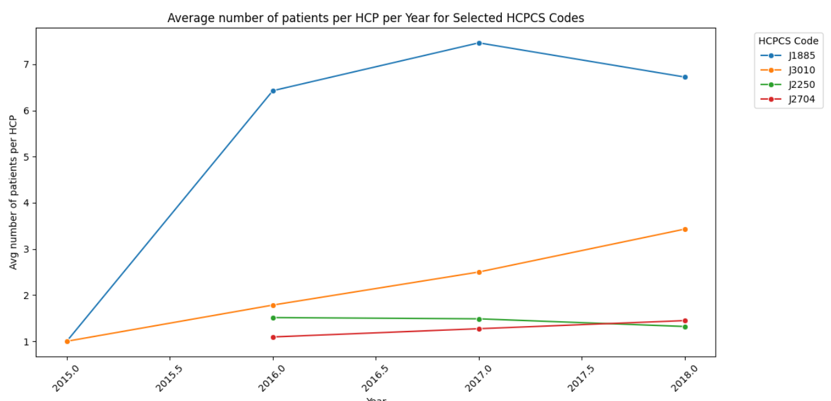
Assess Market Dynamics and Competitive Landscape
Observations:
The average number of claims and patients per HCP are identical, indicating that each HCP typically prescribes an anesthesia drug to at least one patient annually.
Among the four HCPCS codes analyzed, J1885 consistently shows the highest average claims and patient count per HCP, confirming its status as the most widely used product.
J3010 and J2250 demonstrate steady growth, consistently gaining market share.
In contrast, Product 2 shows a consistent decline in performance over the years.

Slide 8
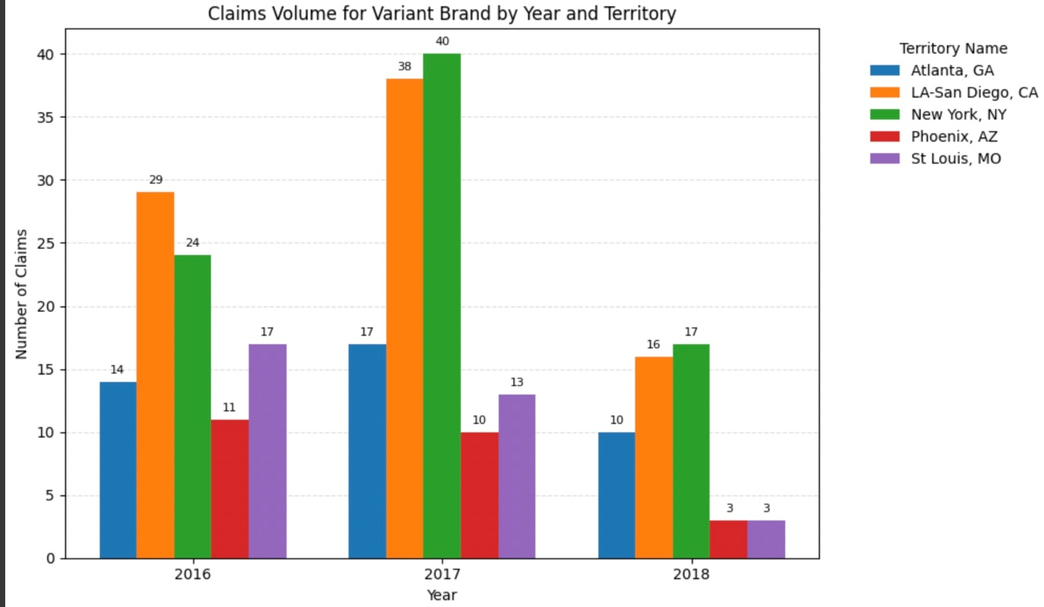
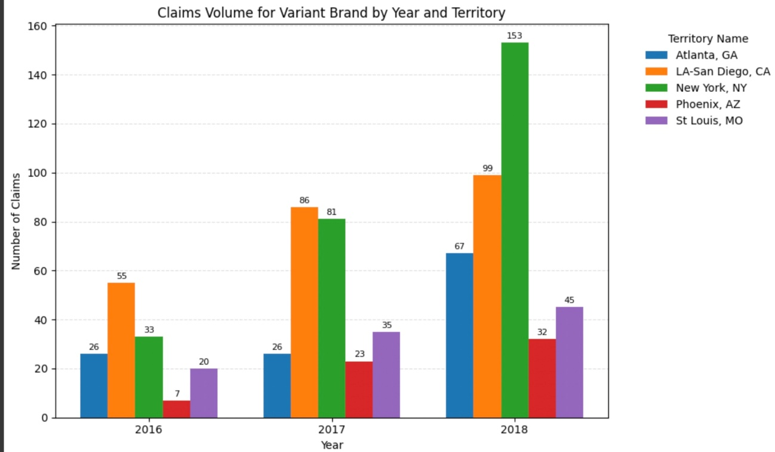
Assess Market Dynamics and Competitive Landscape
Product 2 -
Product 3 -
Product 2 has seen a decline in every territory compared to its competitors who have gained a significant increase.
Observations:
Market demand for anesthesia drugs is growing in the entire country.
HCP adoption is also increasing year over year.
The decline in Product 2 usage is not due to unfavorable market conditions but likely other internal or competitive factors

Slide 9
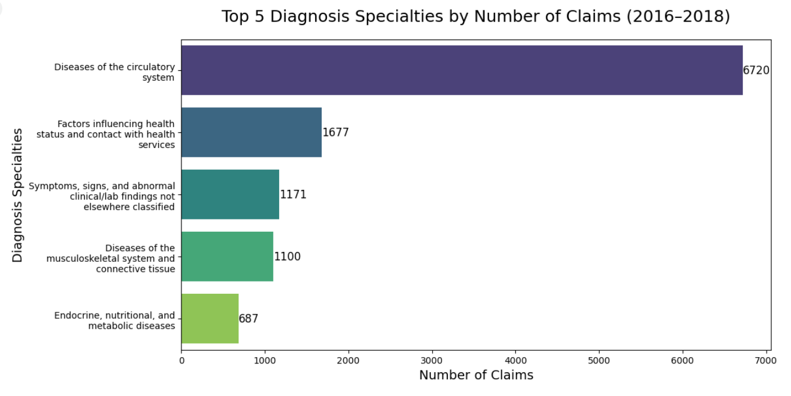
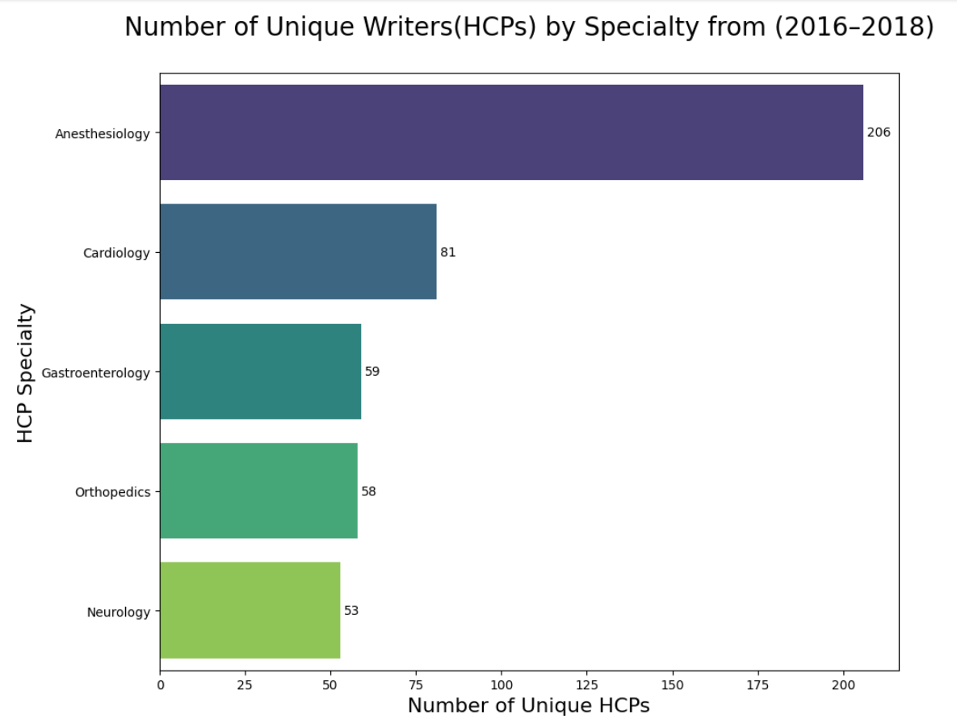
Identify Key Market Driver Trends
Observations
Patients being treated for ‘Diseases of Circulatory Systems’ are the highest number of patients to whom HCPs prescribe anesthesia drugs
HCPs who are Anesthesiologists prescribe these anesthesia drugs the most, followed by Cardiologists.

Slide 10
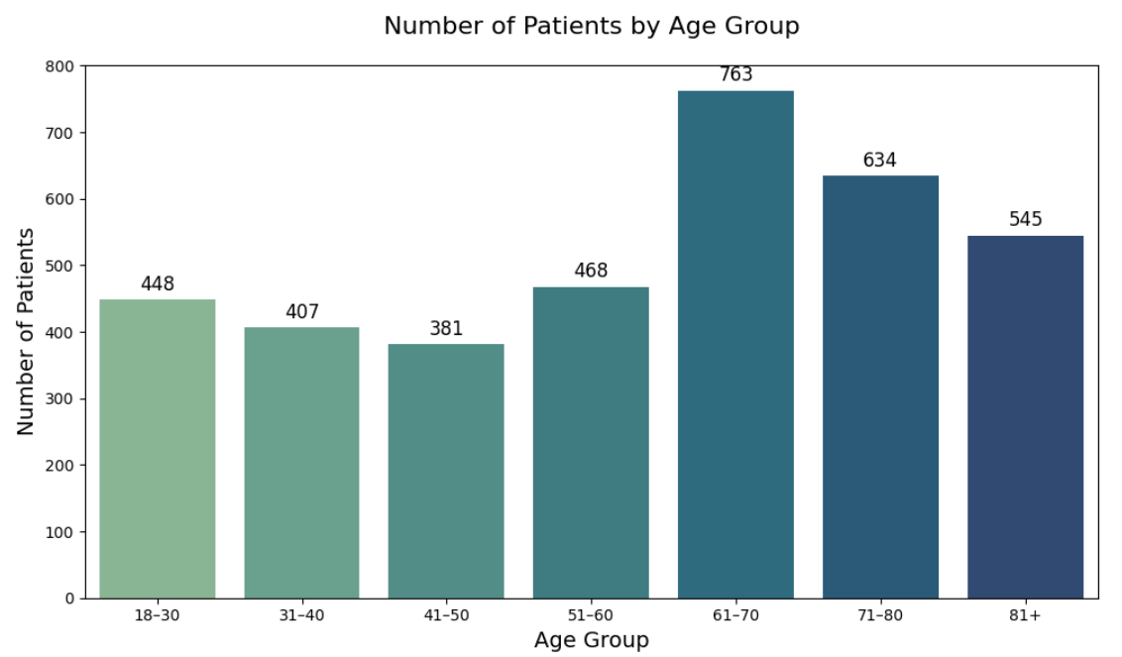
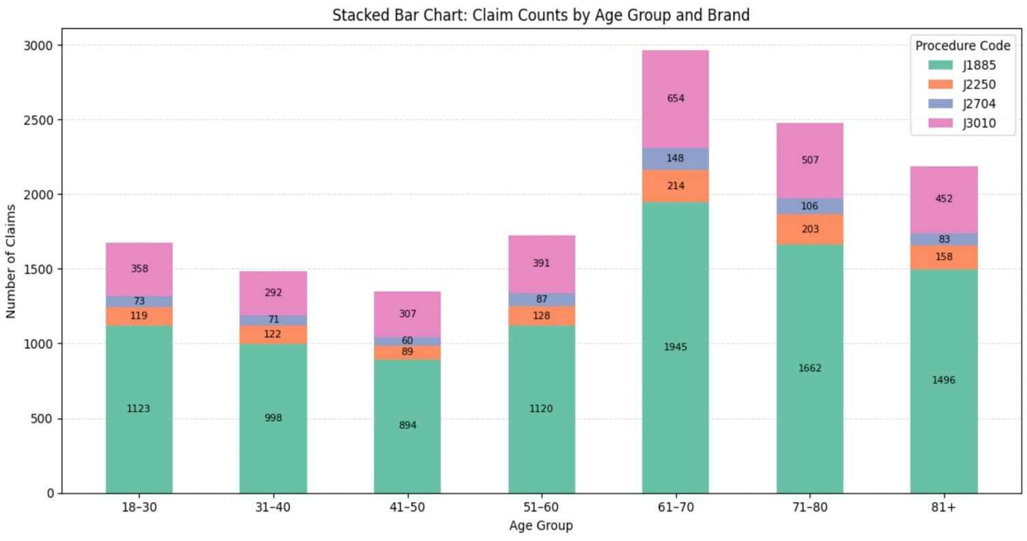
Identify Key Market Driver Trends
Observations:
Historical data indicates that patients aged 61 years and older have a significantly higher demand for anesthesia drugs compared to younger age groups.
This trend likely correlates with a higher incidence of surgical procedures among the elderly population.
Furthermore, the volume of anesthesia drug claims mirrors this demographic pattern, reinforcing the strong association between patient age and the utilization of anesthesia medications.

Slide 11
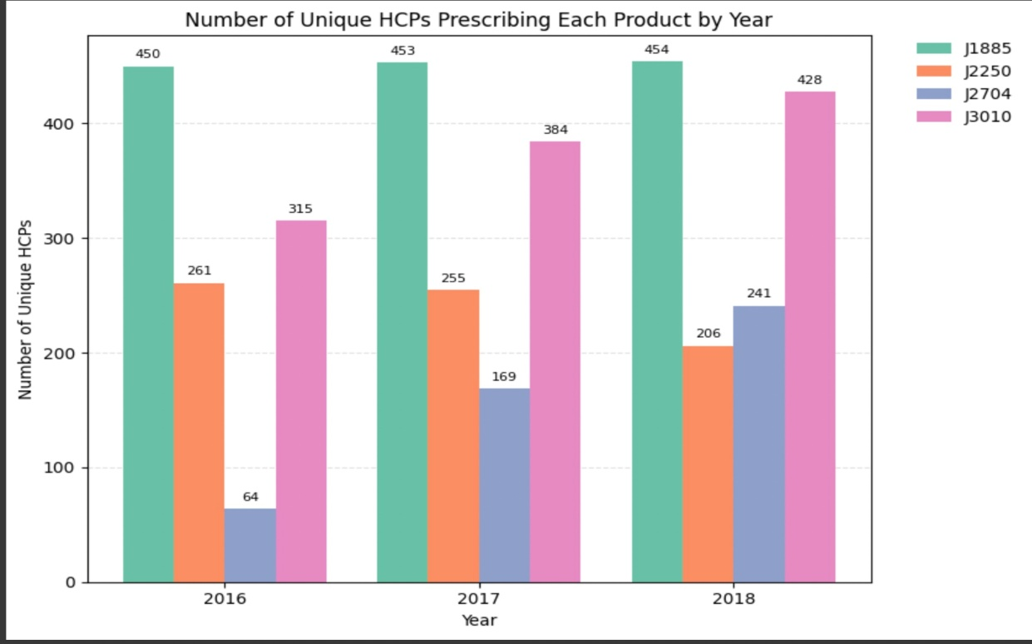
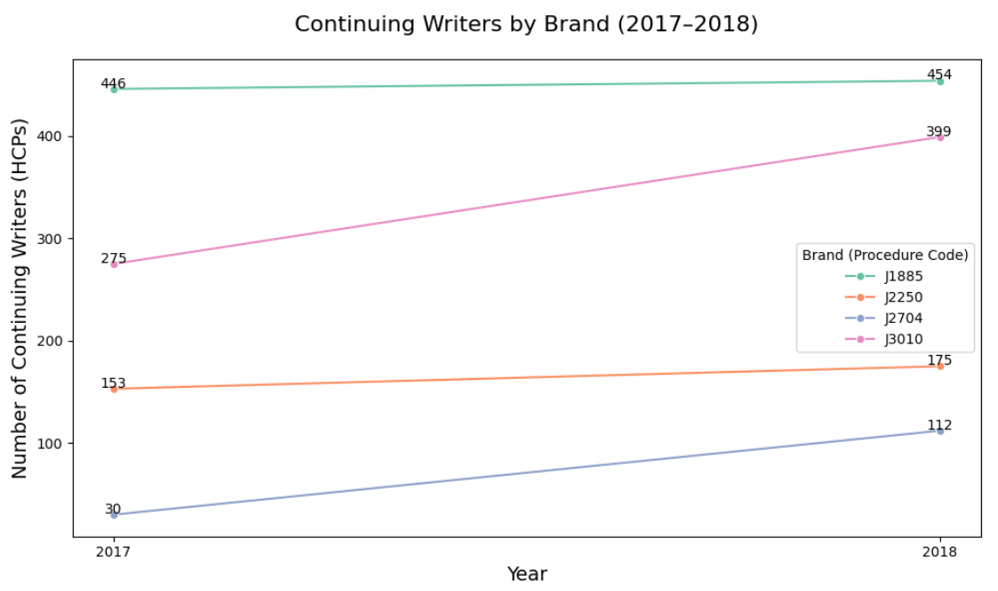
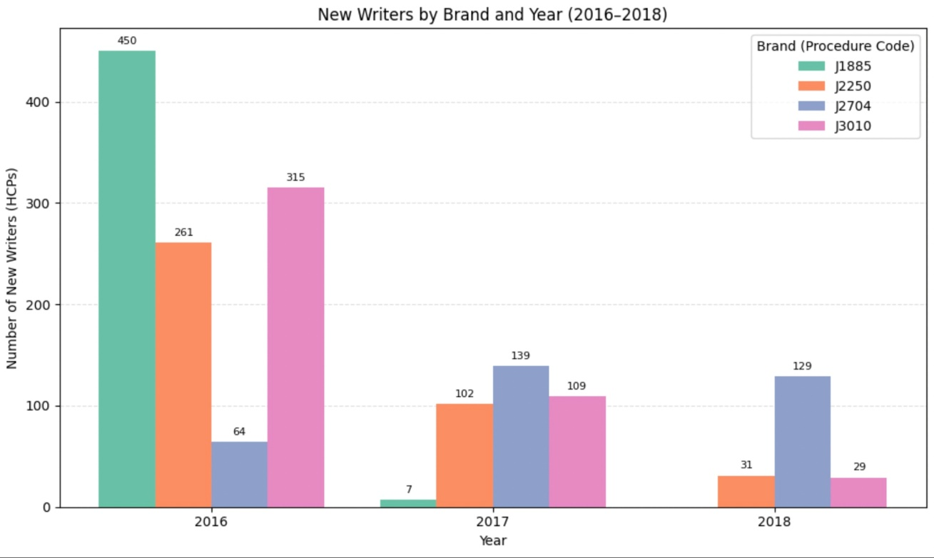
Identify Key Market Driver Trends
Observations:
Product 2 recorded the lowest number of new prescribers in 2017 and failed to acquire any new prescribers in 2018.
While other products demonstrated consistent prescriber retention over time, Product 2 experienced a noticeable decline in its prescriber base.

Slide 12
Uncover Data Gaps and Future Exploration Areas
To assess whether the lower prescription volume of Product 2 is due to supply chain issues, we require additional datasets, including:
DDD Dataset: This can help determine if the reduced availability of Product 2 is a result of disruptions in the wholesale or retail distribution channels.
NPA Dataset: The National Prescription Audit (NPA) provides insights into prescription volumes and trends across all products, manufacturers, and markets through three key channels: retail, mail order, and long-term care.
NPP Dataset: Monitor which digital channels or content types engage physicians most effectively.
To evaluate patient price sensitivity toward our drug—assuming we have visibility into which products are included in formulary wins—we recommend using:
1. NPA Extended Insights: This dataset enhances the standard NPA by including additional variables such as Method of Payment, Co-pay Amount, Patient Age, and Gender. These insights can help assess our pricing strategy and benchmark it against competitors.

Slide 13
Summary of key insights and potential rationale for decline of our product
Key insights from the analyses:
Potential rationale for decline in Product 2 claims:
1
Product 2 has seen the highest y-o-y % drop in claims in 5 territories: Atlanta, GA; LA- San Diego, CA; New York, NY; Pheonix, AZ; St. Louis, MO
A. Sales Force Effectiveness Challenges:
Suboptimal deployment of sales reps across key territories.
Inadequate follow-up and relationship management by the sales team with initial prescribers
B. Distribution and Accessibility Issues:
Supply chain inefficiencies may be reducing product availability and accessibility
C. Brand Positioning and Marketing Strategy Gaps:
Failure to convey the differentiated value proposition of Product 2 as a superior iteration of the original market leader.
Missed opportunities to leverage existing brand equity and HCP loyalty from Product 1 to drive adoption of Product 2
D. Unexpected Pricing Concerns:
Product 2 may be perceived as costlier alternative than its competitors, influencing prescribing behavior in favor of more economical alternatives
2
HCPs with ‘Anesthesia and Cardiology’ specialties are the highest prescribers of anesthesia drugs
3
Highest claims for Anesthesia drugs are received from patients treated for diagnosis specialty ‘Diseases of Circulatory Systems’
4
Highest claims for anesthesia drugs is received from patients above 61 years age

Slide 14



Strategic recommendations for the company
1
2
3
Target the right HCPs
Improve Brand Positioning and Targeting
Address Sales and Distribution concerns
Implement Targeted HCP (Healthcare Professional) Segmentation, ML model : Cluster HCPs by specialties(Anesthesia & Cardiology); geography(Atlanta, LA-San Diego, NY, Pheonix, St.Louis), patient demographics(diagnosis specialty ‘Diseases of Circulatory Systems’ and age group +61yrs)
Business value: Helps sales teams prioritize high-potential prescribers and personalize outreach
A. Campaign Personalization & Optimization using ML model
What ML does: Recommends optimal messaging, channels (email, rep visits, digital ads), and timing based on engagement data. (Leverage the NPP Dataset)
Business value: Increases conversion rates and ROI on marketing spend
B. Position as the most cost-effective drug: do cost analysis to evaluate 2 scenarios (using NPA extended dataset) -
Product 2 has low cost compared to the competitors - We use the cost advantage in our brand positioning and market our product to the HCPs
Product 2 has higher cost than the competitors – Use our budget to issue Co-pay cards, market our product to HCPs informing them that our product has been made cost effective and increase the number of prescribers
C. Leverage existing brand equity and HCP loyalty from Product 1: Promote product 2 as the superior variant of product 1
Use DDD dataset to tracks gaps in accessibility due to low volume of pharmaceutical products shipped from manufacturers or wholesalers to various points of sale (pharmacies, hospitals, clinics)

Slide 15
Appendix
Cost Analysis using claims data:
Used the ‘clm_line_alowd_chrg_amt’ from claims dataset to evaluate the allowable charge for all 4 products.
It represents the amount that the insurer (payer) allows for reimbursement on a specific service line.
Assumption: Payer is paying equal proportion for each product claim as they are same type of drug.
Product | MIN ($) | MAX ($) | MEAN ($) | MEDIAN ($)
J2250 Product 2 | 0 | 228.08 | 48.64929 | 9.225
J3010 Product 3 | 0 | 237.07 | 63.76727 | 70.32
J2704 Product 4 | 9.18 | 242.48 | 87.14333 | 92.405
Additional HCPs with Anesthesiology as specialty
Other than the HCPs who are currently prescribing any of these 4 products, these are additional 200 HCPs who are anesthesiologists not prescribing any of these drugs. We can target these new HCPs in the later phase of marketing (after we have exhausted targeting the HCPs in the currently list)

Slide 16
Q&A

Slide 17
Thank you!

